Slide 1
DIGITAL PORTFOLIO
STUDENT NAME: SUGANYA E
REGISTER NO AND NMID:astvu24724724u18037
DEPARTMENT: COMPUTER SCIENCE
COLLEGE: CHEZHIAN ARTS AND SCIENCE COLLEGE FOR WOMEN/THIRUVALLUVAR UNIVERSITY

Slide 2
ART DIRECTOR PORTFOLIO

Slide 3
AGENDA
PROBLEM STATEMENT
PROJECT OVERVIEW
END USERS
TOOLS AND TECHNOLOGIES
PORTFOLIO DESIGN AND LAYOUT
FEATURES AND FUNCTIONALITY
RESULTS AND SCREENSHOTS
CONCLUSION
GITHUB LINK

Slide 4
PROBLEM STATEMENT
"Develop a visually stunning portfolio that showcases my expertise in art direction, highlighting my ability to craft compelling narratives through innovative design, typography, and imagery. The portfolio should demonstrate my range and versatility in creating impactful visual experiences across various mediums. By showcasing my best work, I aim to attract new clients and career opportunities. The design should be cohesive, modern, and reflective of my unique aesthetic. Ultimately, the portfolio should effectively communicate my value as a creative leader and art director.”

Slide 5
PROJECT OVERVIEW
"Curated portfolio showcasing expertise in art direction, highlighting innovative design solutions and compelling visual storytelling. This project demonstrates creative vision and technical skills through a selection of best works. The portfolio is designed to attract new clients and career opportunities. It features a cohesive and modern aesthetic, showcasing versatility across various mediums. Elevating personal brand through impactful visuals.”

Slide 6
END USERS
"Potential clients seeking art direction services, creative agencies, design firms, and advertising companies. The portfolio targets industry professionals, creative directors, and hiring managers. It also caters to art directors, designers, and creatives looking for inspiration or collaboration opportunities. The end users are individuals or organizations seeking innovative and effective visual storytelling solutions.”

Slide 7
TOOLS AND TECHNOLOGIES
"Utilizing industry-standard design software such as Adobe Creative Suite (Photoshop, Illustrator, InDesign). Employing techniques like visual storytelling, brand identity development, and typography. Leveraging digital platforms like Behance or website builders to showcase work. Incorporating multimedia elements, interactive experiences, and motion graphics to enhance engagement. Staying up-to-date with design trends and technologies to ensure a modern and impactful portfolio.”

Slide 8
PORTFOLIO DESIGN AND LAYOUT
"Clean and minimalist layout showcasing high-impact visuals and projects. Strategic use of typography, color palette, and whitespace to enhance visual flow. Organized into clear sections or categories, with concise project descriptions and context. Incorporating bold imagery, creative direction, and attention to detail to demonstrate art direction expertise. Visually cohesive and reflective of personal brand aesthetic.”

Slide 9
FEATURES AND FUNCTIONALITY
"Visually engaging project showcases with high-quality images and videos. Easy navigation and filtering by project type or industry. Case studies highlighting creative process and problem-solving skills. Interactive elements, such as animations or scrolling effects, to enhance user experience. Responsive design ensuring seamless viewing across devices and screen sizes.”

Slide 10
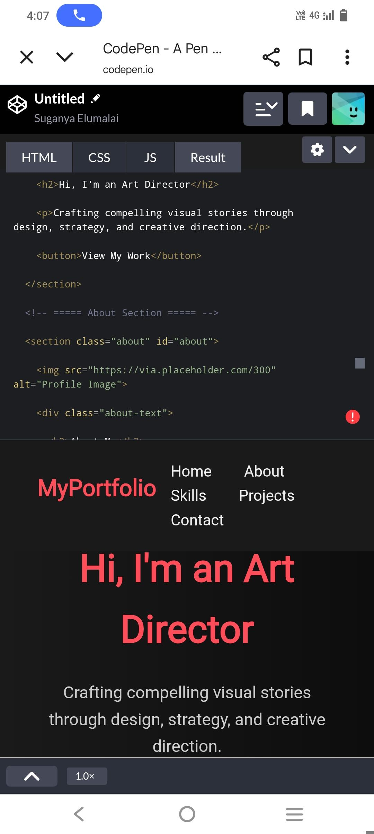
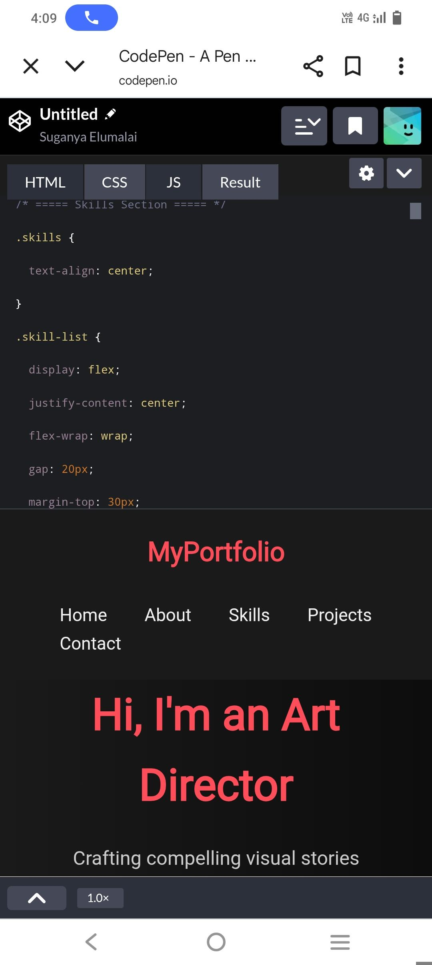
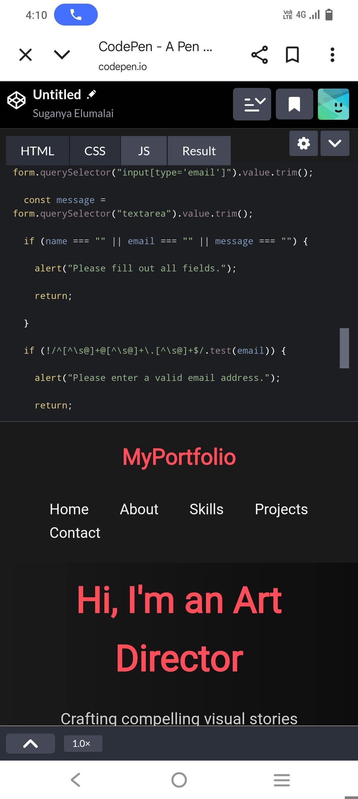
RESULTS AND SCREENSHOTS
"High-quality images and videos showcasing final designs and campaigns. Screenshots of websites, ads, and branding materials demonstrating visual direction. Before-and-after comparisons highlighting design impact and effectiveness. Detailed project descriptions and metrics illustrating success. Visual evidence of creative problem-solving and art direction expertise.”

Slide 11
CONCLUSION
"A well-crafted art director portfolio showcases creative vision and technical expertise. It communicates personal brand and style, attracting clients and career opportunities. Compelling visuals and case studies demonstrate impact and value. Elevates professional presence and establishes industry credibility. Empowers career advancement and business growth.”

